Slide 1
Micron IPAL
Application Team
Sep 2024
Rev 2

Slide 2
Overall Objectives
To conduct ROi trial with Micron IPAL Synthetic Feed to achieve:
1. ROi system recovery of 92%
2. Final Reject IPA Concentration = 24,992 mg/L
3. Final Permeate IPA Concentration = 0.7 mg/L

Slide 3
Projection
Overall recovery rate = 92.0%
Parameter | UNIT | 3 | 4 | 5 | 6 | 7 | 8 | 9 | 10 | 11 | 12 | 13 | 14
List of Substance |  | RO P1 Inlet | RO P1 Reject | RO P1 Permeate | RO P2 Inlet | RO P2 Reject | RO P2 Permeate | RO P3 Inlet | RO P3 Reject | RO P3 Permeate | RO P4 Inlet | RO P4 Reject | RO P4 Permeate
Pass Recovery |  |  |  | 93.0% |  |  | 90.2% |  |  | 80.2% |  |  | 70.0%
Average Flowrate | m³/h | 24.3 | 1.6 | 21.1 | 27.6 | 2.7 | 24.9 | 32.8 | 6.5 | 26.3 | 26.3 | 7.9 | 18.4
Average Flowrate | gpm | 107 | 7 | 93 | 121 | 12 | 110 | 144 | 29 | 115 | 115 | 35 | 81
Pressure | barg | 24.4 | 3.0 | 1.0 | 23.5 | 3.0 | 1.0 | 20.0 | 3.0 | 1.0 | 19.5 | 3.0 | 1.0
Pressure | psig | 354.0 | 43.5 | 14.5 | 340.5 | 43.5 | 14.5 | 290.5 | 43.5 | 14.5 | 283.5 | 43.5 | 14.5
pH |  | 10 | 10 | 9 - 10 | 9 - 10 | 9 - 10 | 9 - 10 | 9 - 10 | 9 - 10 | 9 - 10 | 9 - 10 | 9 - 10 | 8 - 9
Operating Temperature | ºC | 25 | 25 | 25 | 25 | 25 | 25 | 25 | 25 | 25 | 25 | 25 | 25
Operating Temperature | ºF | 77 | 77 | 77 | 77 | 77 | 77 | 77 | 77 | 77 | 77 | 77 | 77
Total Suspended Solids (TSS) | mg/l | <5 | <62.5 | <1 | <1 | <1 | <1 | <1 | <1 | <1 | <1 | <1 | <1
Total Dissolved Solids (TDS) | mg/l | 165 | 1250 | 0.3 | 0.2 | 2.3 | 0.0 | 0.0 | 0.0 | 0.0 | 0.0 | 0.0 | 0.0
Chemical Oxygen Demand (COD) | mg/l | 9478 | 59981 | 1819 | 1656 | 14205 | 295 | 242 | 1126 | 24 | 24 | 76 | <1
Total Organic Carbon (TOC) | mg/l | 3554 | 22493 | 682 | 621 | 5327 | 111 | 91 | 422 | 9 | 9 | 28 | 0.6
Isopropyl alcohol (IPA) | mg/l | 3949 | 24992 | 758 | 690 | 5919 | 123 | 101 | 469 | 10 | 10 | 32 | 0.7
Isopropyl alcohol (IPA) | % | 0.39% | 2.50% | 0.08% | 0.07% | 0.59% | 0.01% | 0.01% | 0.05% | 0.0010% | 0.0010% | 0.003% | 0.0001%
Type of Flow |  | Continuous | Continuous | Continuous | Continuous | Continuous | Continuous | Continuous | Continuous | Continuous | Continuous | Continuous | Continuous

Slide 4
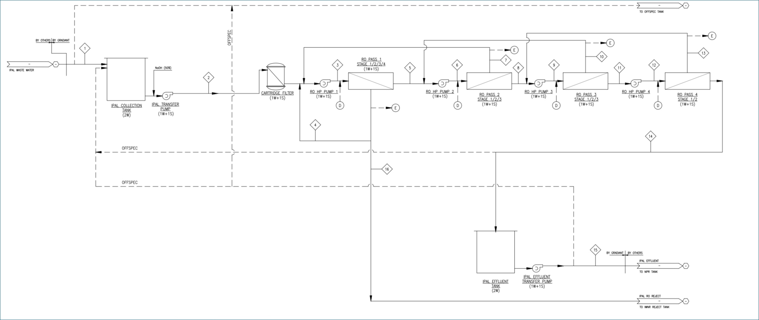
Process Flow Diagram

Slide 5
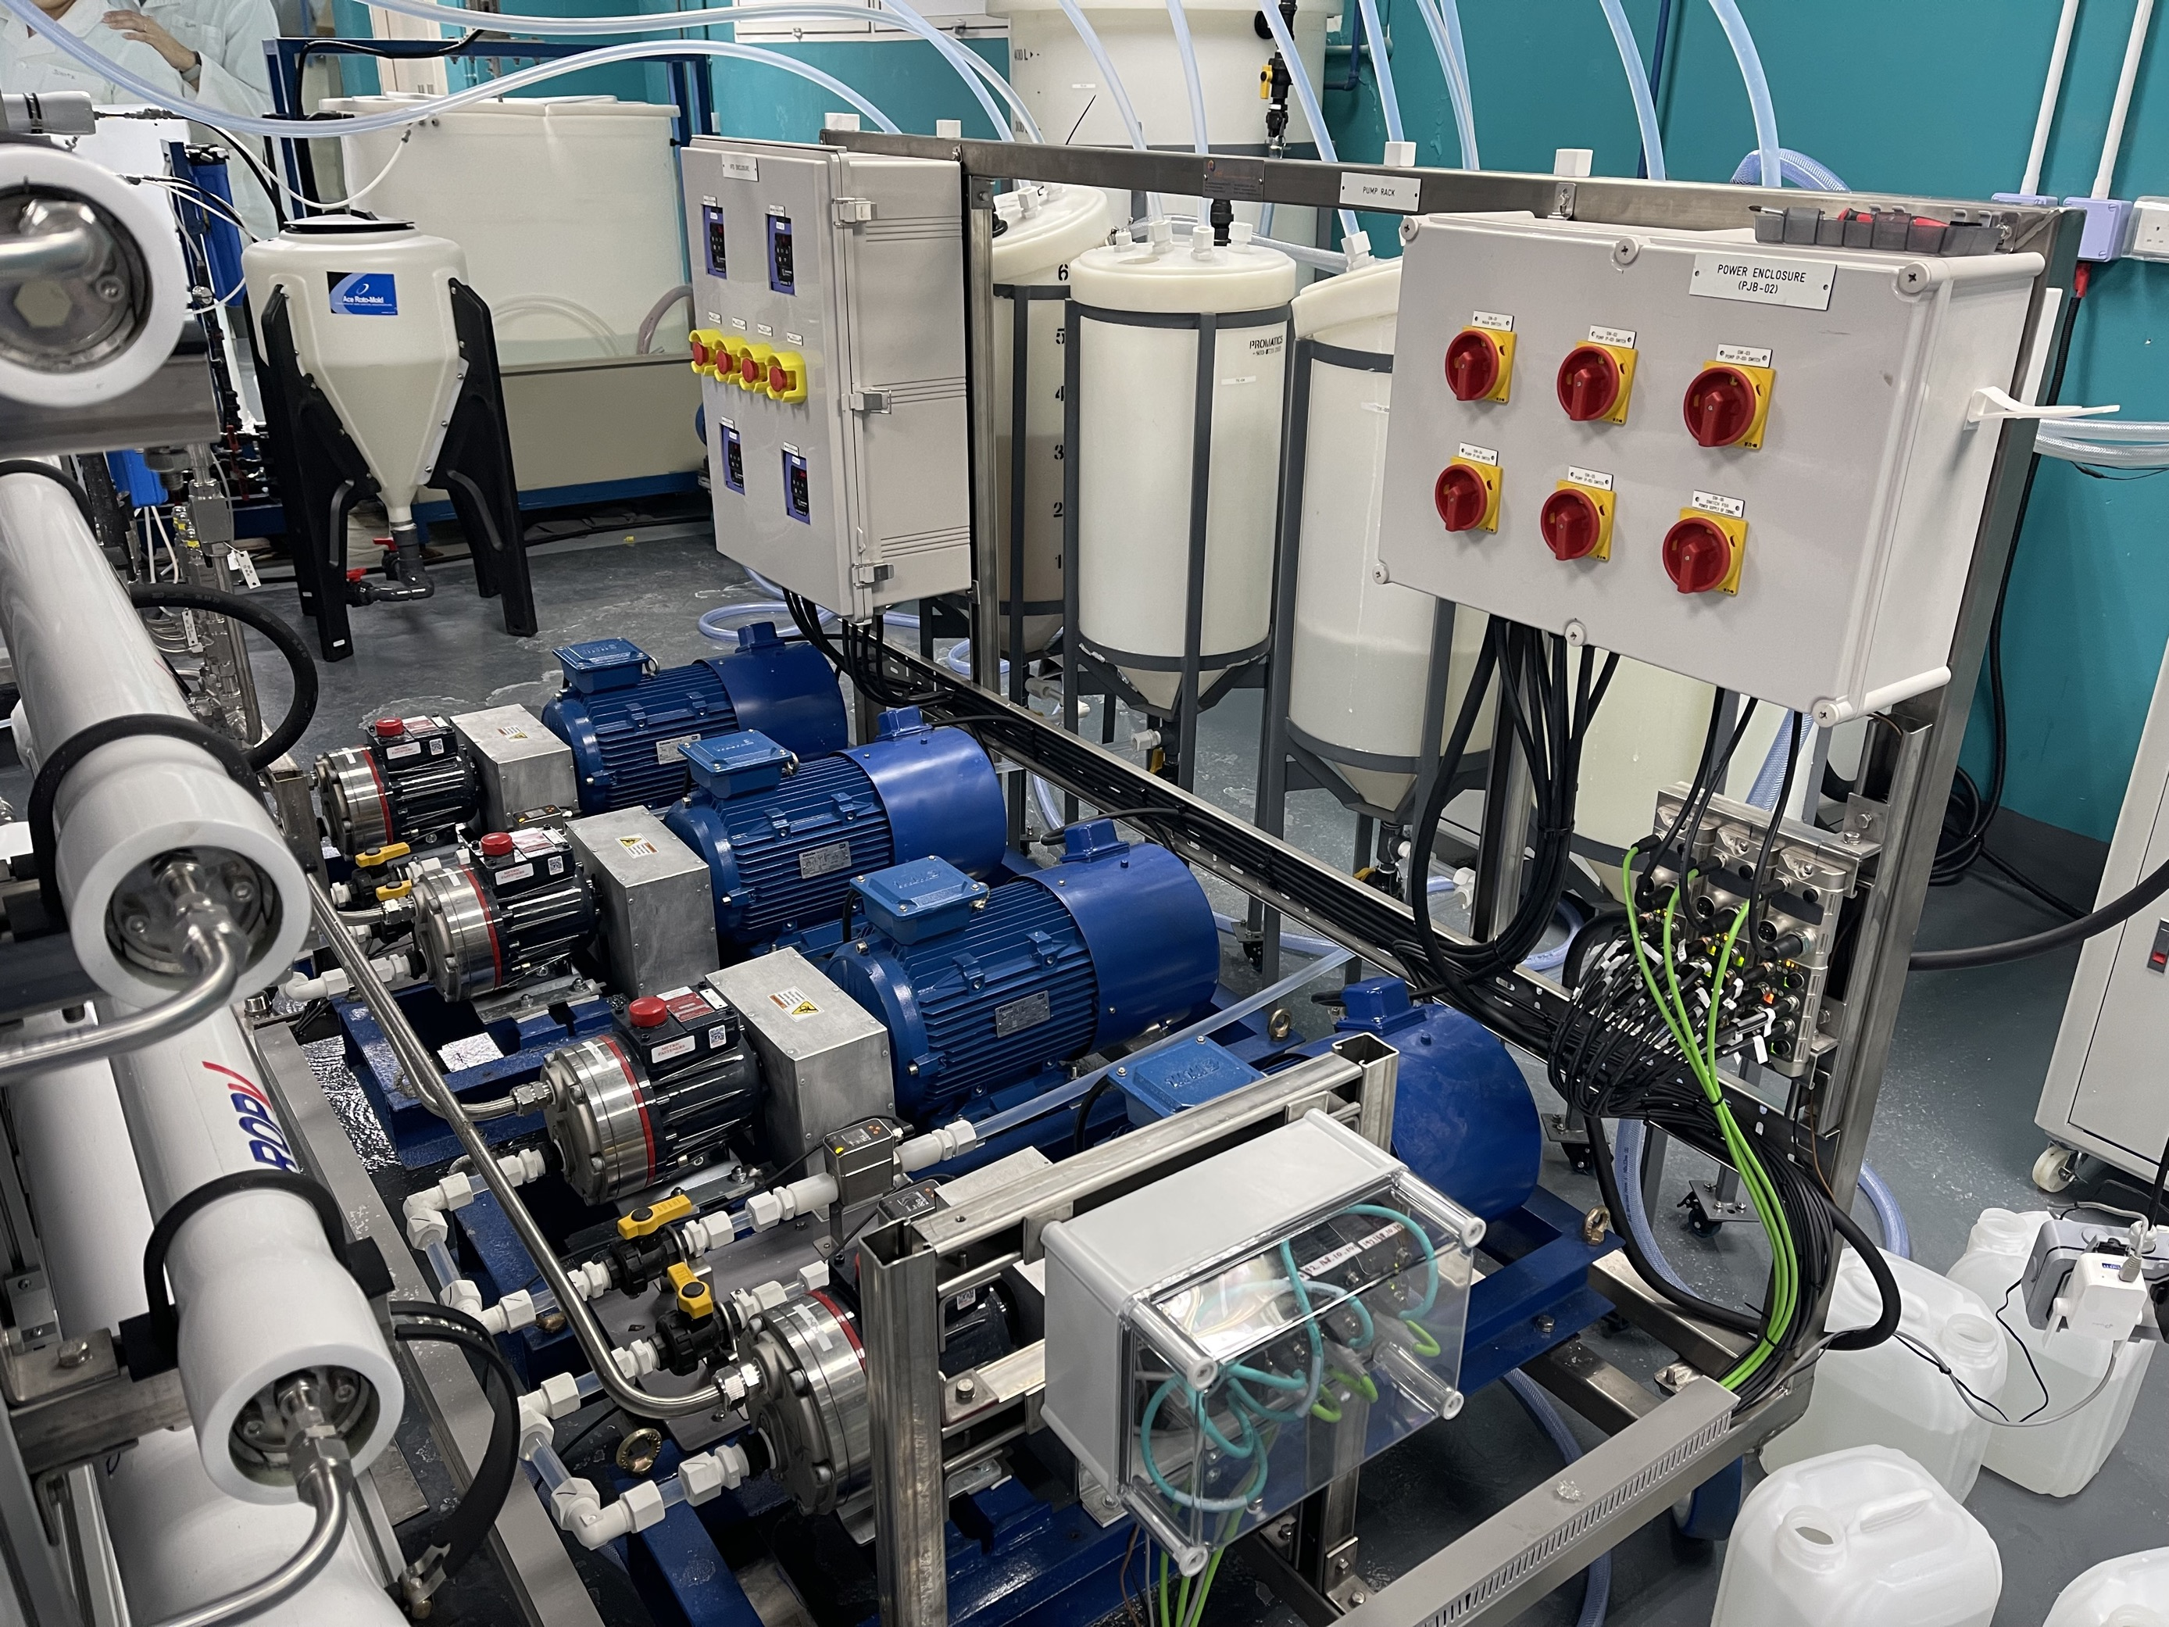
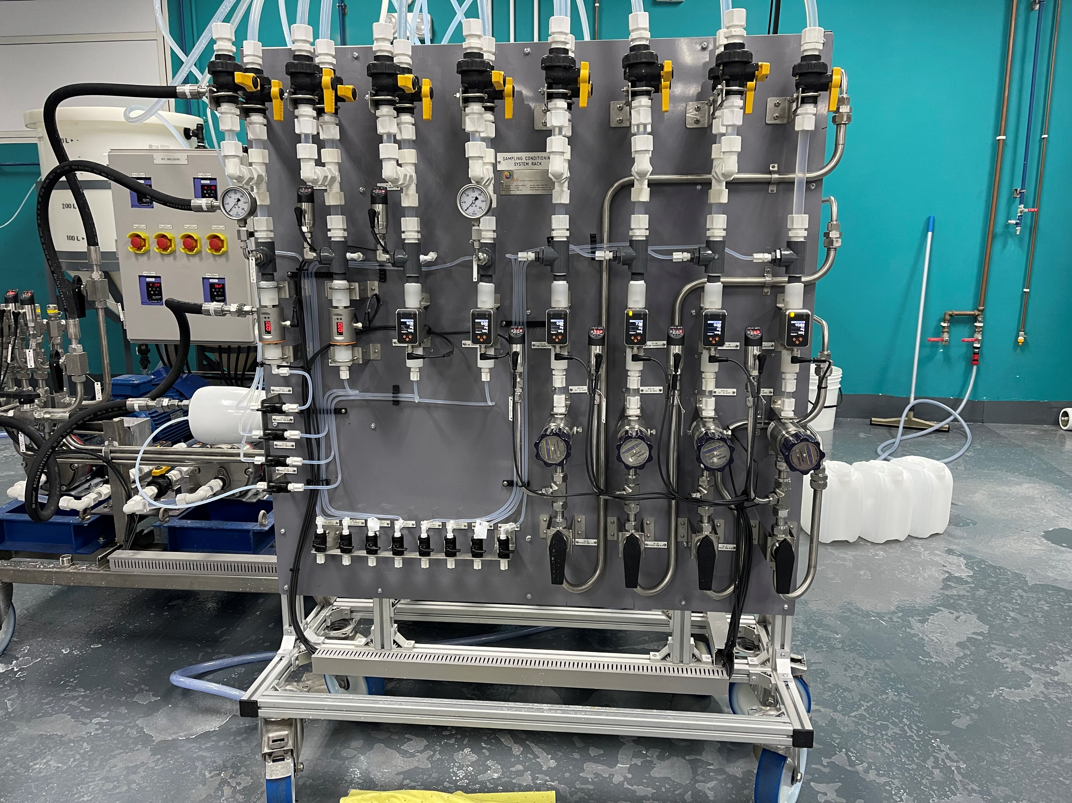
Lab skid

Slide 6
Test Methodology
Perform pretreatment testing
Prepare Synthetic Feed – 102L
Perform water analysis
Perform ROI concentration testing
Prepare IPA calibration curves for RI, TOC and COD.
Perform antiscalant projections to determine necessity of pretreatment, antiscalant type, and dosage.
Synthetic feed was prepared with tap water and 99.5% IPA solution.
pH adjustment from pH 7.53 to 10.21 was performed by dosing 50% NaOH (3.012 mL)
Analyse synthetic feed with RI, ICP-OES, IC, TOC & COD analysers.
Load Pro-LF1 membranes into pressure vessels
Start the pumps to circulate the feed water into the system with reject returned into feed tank while permeate is collected separately
Record flow rates, pressures & collect samples for RI, COD, TOC analysis (conversion to [IPA] by calibration curve) at regular intervals
Stop current ROI stage testing when expected volume of permeate is generated
Collect samples of feed, permeate & reject for water analysis
Further concentration of feed is required if target IPA concentration for reject is not achieved.

Slide 7
Determining IPA Concentrations using RI, TOC and COD
IPA standards ranging from 0 to 30,000 mg/L were prepared and sent for RI, TOC and COD analysis.
Graphs of RI, TOC and COD values obtained against IPA concentrations were plotted.

Slide 8
RI Calibration Graphs
Concentration of IPA (mg/L) | RI meter reading
0 | 1.3326
25 | 1.3325
50 | 1.3325
100 | 1.3325
251 | 1.3326
502 | 1.3326
1005 | 1.3326
2512 | 1.3327
5024 | 1.3330
10048 | 1.3335
25120 | 1.3349
30144 | 1.3351
RI is not capable of measuring [IPA] < 5000 mg/L.

Slide 9
RI, TOC and COD Readings for Samples with different [IPA]
TOC (mg/L) | [IPA] from TOC (mg/L)
2383 | 4107
3518 | 6121
3903 | 6804
4739 | 8287
5881 | 10313
7836 | 13782
9717 | 17120
14200 | 25074
24950 | 44148
Refractive Index | [IPA] from RI (mg/L) | RI Deviation from TOC (%)
- | - | -
1.3328 | 3333 | -46%
1.3329 | 4444 | -35%
1.3330 | 5556 | -33%
1.3332 | 7778 | -25%
1.3336 | 12222 | -11%
1.3338 | 14444 | -16%
1.3344 | 21111 | -16%
1.3364 | 43333 | -2%
COD (mg/L) | [IPA] from COD (mg/L) | COD Deviation from TOC (%)
9900 | 4044 | -2%
14500 | 6019 | -2%
16730 | 6976 | 3%
19800 | 8294 | 0%
27000 | 11384 | 10%
33700 | 14260 | 3%
39000 | 16535 | -3%
57400 | 24433 | -3%
105600 | 45123 | 2%
Refractive index is not used in this study for obtaining [IPA].

Slide 10
COD Calibration Graphs
Concentration of IPA (mg/L) | Expected COD reading (mg/L) | Actual COD reading (mg/L) | COD Deviation
0 | 0.0 | 0 | -
25 | 60.2 | 75 | 25%
50 | 120.4 | 146 | 21%
100 | 240.8 | 269 | 12%
251 | 601.9 | 635 | 6%
502 | 1203.8 | 1246 | 4%
1005 | 2407.5 | 2515 | 4%
2512 | 6018.8 | 6320 | 5%
5024 | 12037.5 | 13520 | 12%
10048 | 24075.1 | 26450 | 10%
25120 | 60187.7 | 56900 | 5%
30144 | 72225.2 | 71400 | 1%
Average COD Deviation |  |  | 10%

Slide 11
TOC Calibration Graphs
Concentration of IPA (mg/L) | Expected TOC reading (mg/L) | Actual TOC Reading (mg/L) | TOC Deviation
0 | 0 | 1.465 | -
25 | 15 | 14.7 | -2%
50 | 30 | 34.8 | 16%
100 | 60 | 57.3 | -5%
251 | 150 | 141 | -6%
502 | 301 | 299 | -1%
1005 | 602 | 574 | -5%
2512 | 1505 | 1396 | -7%
5024 | 3009 | 3612 | 20%
10048 | 6019 | 5690 | -5%
25120 | 15047 | 13980 | -7%
30144 | 18056 | 17170 | -5%
Average TOC Deviation |  |  | -1%
Average deviation from expected reading is -1%, TOC calibration graph is used in this study to obtain [IPA].

Slide 12
Water Analysis – Micron IPAL Feed
PARAMETER | METHOD | UNIT | IPAL P1 Inlet
pH | pH probe | - | 10.19
Conductivity | Conductivity probe | µS/cm | 285
Carbonate Alkalinity, CO3/ P-Alkalinity​ | APHA 2320B​ | CaCO3 mg/l​ | 25​
Bicarbonate Alkalinity, HCO3/ M-Alkalinity​ | APHA 2320B​ | CaCO3 mg/l​ | ​28
Total Alkalinity​ | APHA 2320B​ | CaCO3 mg/l​ | 53
Fluoride as F | Ion Chromatography | mg/l | 0.512
Chloride as Cl | Ion Chromatography | mg/l | 28.996
Phosphate as PO₄ | Ion Chromatography | mg/l | <0.1
Sulphate as SO₄ | Ion Chromatography | mg/l | 38.917
Nitrite as NO₂ | Ion Chromatography | mg/l | <0.1
Nitrate as NO₃ | Ion Chromatography | mg/l | 2.773
Aluminium as Al | EPA200.7 | mg/l | <0.1
Boron as B | EPA200.7 | mg/l | 0.172
Calcium as Ca | EPA200.7 | mg/l | 11
Germanium as Ge | EPA200.7 | mg/l | 0.24
Magnesium as Mg | EPA200.7 | mg/l | 3.13
Potassium as K | EPA200.7 | mg/l | 15.6
Dissolved Silica SiO4 | EPA200.7/ Calculation | mg/l | 2.06
Sodium as Na | EPA200.7 | mg/l | 27.4
Total Hardness as CaCO3 | EPA200.7/ Calculation | mg/l | 40.3
TOC | APHA 5310B | mg/l | 2383
COD | Hach 8000 | O₂ mg/l | 9900
TDS | Ultrameter | mg/l | 160
TDS | APHA 2540C | mg/l | 199

Slide 13
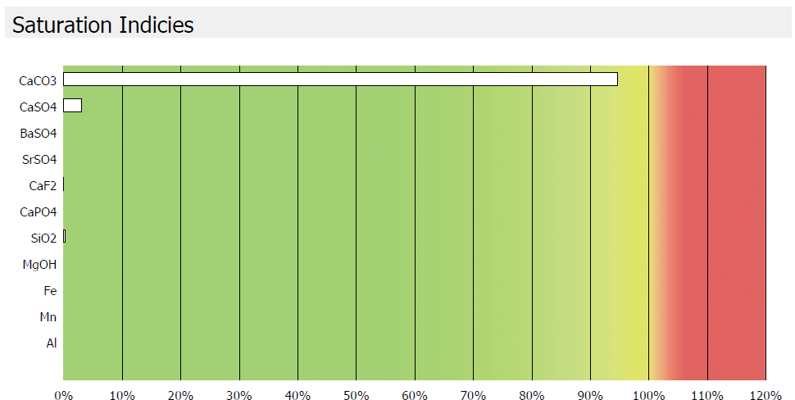
Antiscalant Projection
Target recovery: 93%
pH adjusted from 7.5 to 10.21, using 50% NaOH (3.012 mL for 102L)
Antiscalant: Cure AT9530 @ 2 ppm
In this ROi trial, no antiscalant was dosed.

Slide 14
Experiment 1.1: ROi Pass 1 Trial

Slide 15
Objectives for Pass 1
To conduct ROi trial with Micron IPAL Synthetic Feed to achieve:
1. ROi system recovery of 93%
2. Pass 1 Reject IPA Concentration = 24,992 mg/L
3. Pass 1 Permeate IPA Concentration = 758 mg/L

Slide 16
Water Analysis – Pass 1 Results
Time (minutes) | P1 Feed TDS (mg/L) | P1 Feed [IPA] from TOC (mg/L) | P1 Permeate TDS (mg/L) | P1 Permeate [IPA] from TOC (mg/L) | Volume of P1 Permeate Collected (L) | Recovery by Volume | Recovery by CF | Rejection by TOC
0 | 160.10 | 4107 | - | - | 0 | - | - | -
32 | 214.30 | 6121 | 15.30 | 91 | 33 | 0.32 | 0.33 | 0.985203
42 | 216.00 | 6804 | 3.37 | 111 | 45 | 0.44 | 0.40 | 0.983734
51 | 267.00 | 8287 | 3.32 | 139 | 55 | 0.54 | 0.50 | 0.983170
61 | 344.90 | 10313 | 2.65 | 167 | 65 | 0.64 | 0.60 | 0.983817
72 | 450.80 | 13782 | 2.18 | 231 | 75 | 0.74 | 0.70 | 0.983244
79 | 537.50 | 17120 | 2.34 | 303 | 80 | 0.78 | 0.76 | 0.982275
88 | 723.40 | 25074 | 3.45 | 486 | 87 | 0.85 | 0.84 | 0.980623
104 | 1283.00 | 44148 | 40.00 | 1318 | 95 | 0.93 | 0.91 | 0.970135
*Initial Feed Volume: 102L

Slide 17
Water Analysis – Pass 1 Results: pH
Time (minutes) | P1 Feed [IPA] (mg/L) | P1 Feed pH | P1 Permeate [IPA] (mg/L) | P1 Permeate pH
0 | 4107 | 10.21 | - | -
32 | 6121 | 10.11 | 91 | 8.44
42 | 6804 | 10.05 | 111 | 8.78
51 | 8287 | 10.00 | 139 | 8.12
61 | 10313 | 10.01 | 167 | 8.86
72 | 13782 | 9.98 | 231 | 8.55
79 | 17120 | 9.97 | 303 | 8.76
88 | 25074 | 9.85 | 486 | 8.93
104 | 44148 | 9.59 | 1318 | 8.94
Notes:
Mention P1 permeate IPA concentration might be even lower due to over-concentration (To add in discussion)

Slide 18
ROi Concentration Results
List of Substance | P1 Inlet | Final P1 Reject | Final P1 Permeate
Projection [IPA] (mg/L) | 3949 | 24992 | 758
Actual [IPA] (mg/L) | 4107 | 46383 | 210
Operating parameters:
- Average Feed pressure: 335 psi
- Average Feed Flow rate: 9 LPM
-Membrane: Pro-LF1

Slide 19
Flux Vs IPA Concentration

Slide 20
Rejection Vs IPA Concentration

Slide 21
Discussions
Time (Day) | P1 Permeate [IPA] from TOC (mg/L)
0 | 210
1 | 197
After 1 day, the IPA concentration of Pass 1 permeate decreased to 197 mg/L.
List of Substance | P1 Inlet | P1 Reject | P1 Permeate | P2 Inlet | P2 Reject | P2 Permeate | P3 Inlet | P3 Reject | P3 Permeate | P4 Inlet | P4 Reject | P4 Permeate
Projection [IPA] (mg/L) | 3949 | 24992 | 758 | 690 | 5919 | 123 | 101 | 469 | 10 | 10 | 32 | 0.7
Actual [IPA] (mg/L) | 4107 | 46383 | 210 | 197 | - | - | - | - | - | - | - | -
P1 Permeate value (197 mg/L) is closer to P3 Inlet (101 mg/L) than P2 Inlet (690 mg/L).
One pass is sufficient to achieve permeate with quality projected to be achieved with 2 passes.
Decreasing Pass 1 recovery may achieve P1 Reject and Permeate with closer values to projection.
Pass 2 is run with P2 Inlet = 197 mg/L instead.

Slide 22
Conclusion
List of Substance | P1 Inlet | Final P1 Reject | Final P1 Permeate
Projection [IPA] (mg/L) | 3949 | 24992 | 758
Actual [IPA] (mg/L) | 4107 | 46383 | 210
ROi recovery 91.1% (by CF) and 93% ( by Volume).

Slide 23
Experiment 1.2: ROi Pass 2 Trial

Slide 24
Objectives for Projected Pass 2
To conduct ROi trial with Micron IPAL Synthetic Feed to achieve:
1. ROi system recovery of 90.2%
2. Pass 2 Reject IPA Concentration = 5919 mg/L
3. Pass 2 Permeate IPA Concentration = 123 mg/L

Slide 25
Water Analysis – Pass 2 Results
Time (minutes) | P2 Feed TDS (mg/L) | P2 Feed [IPA] from TOC (mg/L) | P2 Permeate TDS (mg/L) | P2 Permeate [IPA] from TOC (mg/L) | Volume of P2 Permeate Collected (L) | Recovery by Volume | Recovery by CF | Rejection by TOC
0 | 20.43 | 197 | - | - | 0 | - | - | -
37 | 66.61 | 546 | 1.05 | 8.65 | 42 | 0.44 | 0.64 | 0.984162173
55 | 99.32 | 835 | 0.72 | 12.89 | 62 | 0.65 | 0.76 | 0.984552384
66 | 134.60 | 1132 | 1.14 | 15.01 | 73 | 0.77 | 0.83 | 0.986739039
72 | 175.80 | 1546 | 1.44 | 23.55 | 80 | 0.84 | 0.87 | 0.984767077
76 | 214.30 | 1991 | 1.04 | 29.46 | 84 | 0.88 | 0.90 | 0.985205993
*Initial Feed Volume: 95L

Slide 26
Water Analysis – Pass 2 Results: pH
Time (minutes) | P2 Feed [IPA] (mg/L) | P2 Feed pH | P2 Permeate [IPA] (mg/L) | P2 Permeate pH
0 | 197 | 9.10 | - | -
37 | 546 | 9.64 | 8.65 | 8.2
55 | 835 | 9.68 | 12.89 | 8.59
66 | 1132 | 9.70 | 15.01 | 8.07
72 | 1546 | 9.58 | 23.55 | 8.57
76 | 1991 | 9.49 | 29.46 | 8.45

Slide 27
ROi Concentration Results
List of Substance | P2 Inlet | Final P2 Reject | Final P2 Permeate
Projection[IPA] (mg/L) | 690 | 5919 | 123
Actual [IPA] (mg/L) | 197 | 2356 | 12
Operating parameters:
- Average Feed pressure: 260 psi
- Average Feed Flow rate: 9 LPM
-Membrane: Pro-LF1

Slide 28
Flux Vs IPA Concentration

Slide 29
Rejection Vs IPA Concentration

Slide 30
Discussions
Time (Day) | P1 Permeate [IPA] from TOC (mg/L)
0 | 12
2 | 11
After 2 days, the IPA concentration of Pass 2 permeate decreased to 11 mg/L.
List of Substance | P1 Inlet | P1 Reject | P1 Permeate | P2 Inlet | P2 Reject | P2 Permeate | P3 Inlet | P3 Reject | P3 Permeate | P4 Inlet | P4 Reject | P4 Permeate
Projection [IPA] (mg/L) | 3949 | 24992 | 758 | 690 | 5919 | 123 | 101 | 469 | 10 | 10 | 32 | 0.7
Actual [IPA] (mg/L) | 4107 | 46383 | 210 | 197 | 2356 | 12 | 11 | - | - | - | - | -
Actual P2 Permeate value (12 mg/L) is close to P3 Permeate and P4 Inlet projection (10 mg/L).
Two passes were sufficient to achieve permeate with quality projected to be achieved with three passes.
Decreasing Pass 2 recovery may achieve P2 Reject and Permeate with closer [IPA] to projected values.
Pass 3 is run with P3 Inlet = 11 mg/L.
Notes:
We do not have the concrete projection value, should we continue to concentrate down, we should be able to get close to P4 projected values.

Slide 31
Conclusion
List of Substance | P2 Inlet | P2 Reject Final | P2 Permeate Final
Projection[IPA] (mg/L) | 690 | 5919 | 123
Actual [IPA] (mg/L) | 197 | 2356 | 12
ROi recovery 91.6% (by CF) / 88.4% (by Volume).

Slide 32
Experiment 1.3: ROi Pass 3 Trial

Slide 33
Objectives for Projected Pass 4
To conduct ROi trial with Micron IPAL Synthetic Feed to achieve:
1. ROi system recovery of 70.0%
2. Pass 4 Reject IPA Concentration = 32 mg/L
3. Pass 4 Permeate IPA Concentration = 0.7 mg/L

Slide 34
Water Analysis – Pass 3 Results
Time (minutes) | P3 Feed TDS (mg/L) | P3 Feed [IPA] from TOC (mg/L) | P3 Permeate TDS (mg/L) | P3 Permeate [IPA] from TOC (mg/L) | Volume of P3 Permeate Collected (L) | Recovery by Volume | Recovery by CF | Rejection by TOC
0 | 33.00 | 11.32 | - | - | 0 | - | - | -
23 | 44.61 | 42.29 | 0.63 | 0.91 | 25 | 0.32 | 0.73 | 0.978373331
37 | 61.59 | 59.00 | 0.57 | 1.14 | 40 | 0.51 | 0.81 | 0.980759922
48 | 107.90 | 109.00 | 0.85 | 1.97 | 57 | 0.68 | 0.90 | 0.981999482
Initial Feed Volume: 84L
Notes:
Check the TOC again and try to change the CF value, if possible.

Slide 35
Water Analysis – Pass 3 Results: pH
Time (minutes) | P3 Feed [IPA] (mg/L) | P3 Feed pH | P3 Permeate [IPA] (mg/L) | P3 Permeate pH
0 | 11.32 | 8.73 | - | -
23 | 42.29 | 8.93 | 0.91 | 6.84
37 | 59 | 8.83 | 1.14 | 7.45
48 | 109 | 8.60 | 1.97 | 6.66

Slide 36
ROi Concentration Results
List of Substance | TOC (mg/L) | [IPA] (mg/L)
P3 Permeate | 1.91 | 2.39
Tap Water | 1.29 | 1.45
P3 Permeate with [IPA] only | 0.62 | 0.44
List of Substance | P4 Inlet | Final P4 Reject | Final P4 Permeate
Projection[IPA] (mg/L) | 10 | 32 | 0.7
Actual [IPA] (mg/L) | 11 | 135 | 0.44-2.40
Operating parameters:
- Average Feed pressure: 263 psi
- Average Feed Flow rate: 9 LPM
-Membrane: Pro-LF1

Slide 37
Flux Vs IPA Concentration

Slide 38
Rejection Vs IPA Concentration

Slide 39
Discussions & Conclusions
List of Substance | P1 Inlet | P1 Reject | P1 Permeate | P2 Inlet | P2 Reject | P2 Permeate | P3 Inlet | P3 Reject | P3 Permeate | P4 Inlet | P4 Reject | P4 Permeate
Projection [IPA] (mg/L) | 3949 | 24992 | 758 | 690 | 5919 | 123 | 101 | 469 | 10 | 10 | 32 | 0.7
Actual [IPA] (mg/L) | 4107 | 46383 | 197 | 197 | 2356 | 12 | - | - | - | 11 | 135 | 0.44-2.40
Projection Recovery (% v/v) |  |  | 93.0 |  |  | 90.2 |  |  | 80.2 |  |  | 70.0
Actual Recovery (% v/v) |  |  | 93.1 |  |  | 88.4 |  |  | - |  |  | 67.9
Three passes were sufficient to achieve permeate with quality projected to be achieved with four passes.
Decreasing Pass 2 recovery may achieve P3 Reject and Permeate with [IPA] closer to Pass 4 projected values.
ROi recovery 91.6% (by CF) / 67.9% (by volume).

